Slide 1
Lecture 10 生存数据分析

Slide 2
What is survival analysis?
Outcome variable: Time until an event occurs
Time: years, months, weeks, or days
Start follow-up Event
Event: death, disease, relapse, recovery
Time

Slide 3
Time ≡ survival time
It gives the time that an individual has survived over some follow up period
Event ≡ failure
The event of interest usually is death, disease or any other negative individual experience.

Slide 4
Examples
1) Disease-free time until heart disease (years)
Event: Developing heart disease
Outcome: time in years until a person develops heart disease.
2) Time until death (years)
Event: Death
Outcome: Time in years until death
3) Parolees time until get rearrested
Event: Getting rearrested
Outcome: Time in weeks until rearrest

Slide 5
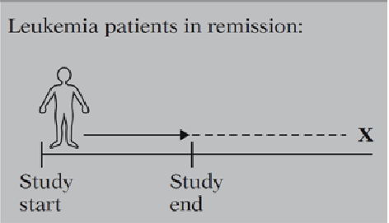
Censored data
We don’t know the survival time exactly.

Slide 6
Why censoring may occur?
A person does not experience the event before the study ends.
A person is lost to follow-up during the study period.
A person withdraws from the study because of some other reason.

Slide 7
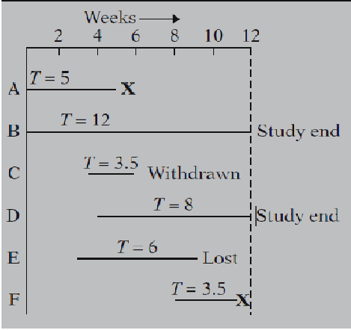
Examples

Slide 8
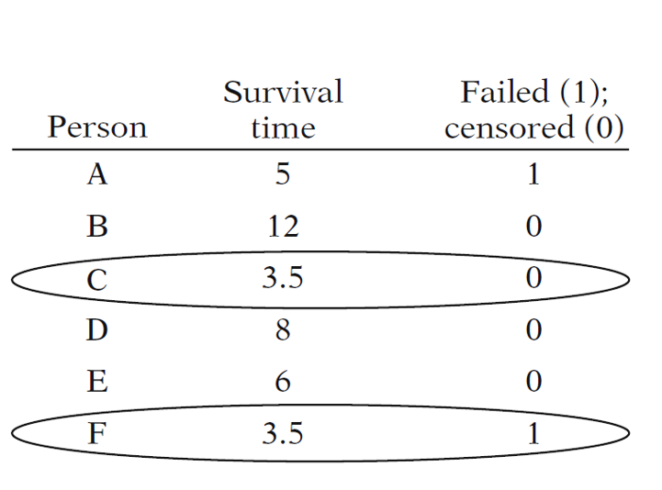
Table of Survival Time

Slide 9
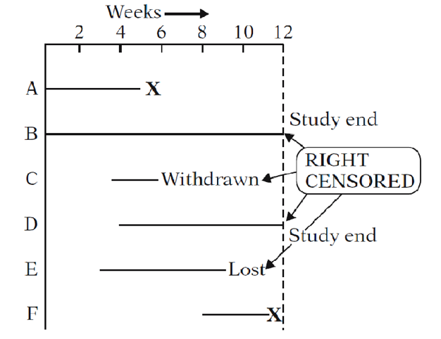
Right Censored Data

Slide 10
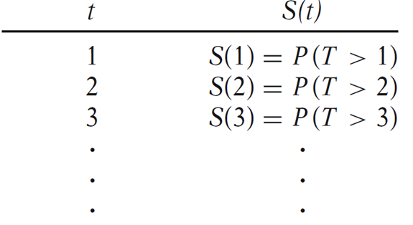

Terminology and Notation
T = Survival time
Survival function

Slide 11
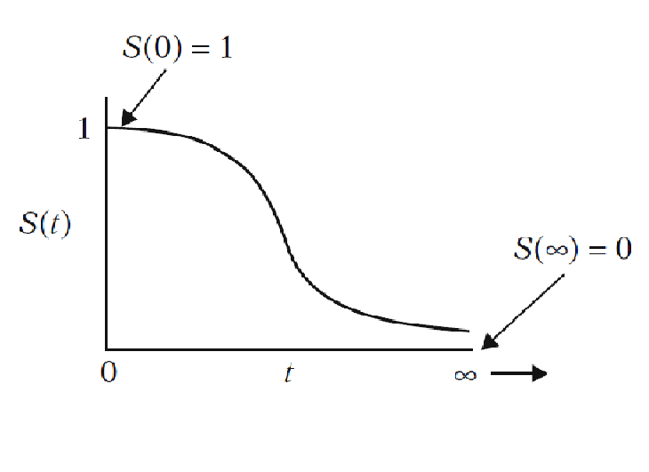
Survival Curve

Slide 12
How to Draw the Survival Curves?
Kaplan-Meier Method
Non-parametric estimate of the survival function.
Commonly used to describe survivorship of study population/s.
Commonly used to compare two study populations.
Intuitive graphical presentation.

Slide 13
Survival Data
Subject A
2. subject A drops out after 6 months
Subject B
Subject C
3. subject C dies at 7 months
X
Subject D
Subject E
X
1. subject E dies at 4 months
Beginning of study
End of study
→ Time in months →

Slide 14
Kaplan-Meier Estimates
Interval [t_{i}, t_{i+1}) | n_{i}=# at risk at time t_{i}⁻ | d_{i}=#deaths | c_{i}=#censored | 1-d_{i}/n_{i} | S(t) Estimate
[0, 4) | 5 | 0 | 0 | 1 | 1
[4, 7) | 5 | 1 | 1 | 4/5 | 4/5=80%
[7, end) | 5-1-1=3 | 1 | 0 | 2/3 | 4/5*2/3=8/15=53%

Slide 15
The product limit estimate
The probability of surviving in the entire study, taking into account censoring = (4/5) (2/3) = 53%
NOTE: > 40% (2/5) because the one drop-out survived at least a portion of the year.
AND <60% (3/5) because we don’t know if the one drop-out would have survived until the end of the year.

Slide 16
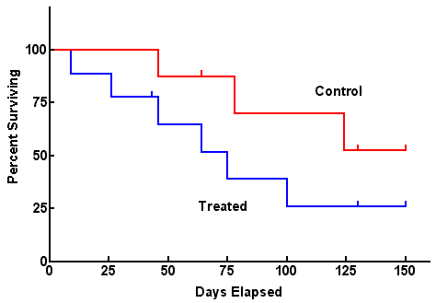
Comparing 2 groups
Use log-rank test to test the null hypothesis of no difference between survival functions of the two groups

Slide 17
Example:
Event = time to relapse
Data:
10, 20+, 35, 40+, 50+, 55, 70+, 71+, 80, 90+

Slide 18
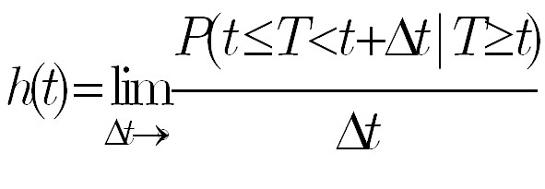
Hazard function
The hazard function gives the instantaneous potential per unit time for the event to occur, given that the individual has survived up to time t.

Slide 19
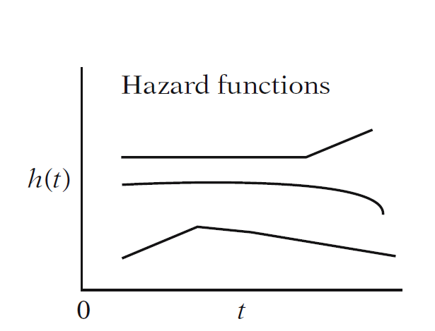
Different type of hazard functions

Slide 20
Hazard function
Derivation (Bayes’ rule):

Slide 21
Hazard vs. density
When you are born, you have a certain probability of dying at any age; that’s the probability density (think: marginal probability)
Example: a woman born today has, say, a 1% chance of dying at 80 years.
However, as you survive for awhile, your probabilities keep changing (think: conditional probability)
Example, a woman who is 79 today has, say, a 5% chance of dying at 80 years.

Slide 22
Summary of relationships
Cumulative probability distribution:
Survival function:
Hazard function:
Cumulative Hazard function:

Slide 23
Exponential distribution
Exponential density function:
Survival function:
Constant hazard function:
Cumulative Hazard function:

Slide 24
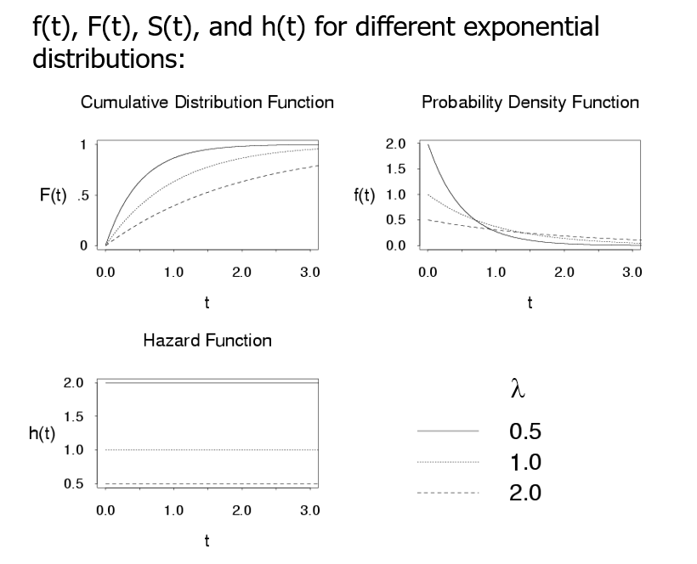
Exponential
(hazard is constant over time, simplest!)
The hazard function does not depend on t, so the probability of failure in the time interval [t, t +dt] is not related to how long the subject has already survived. This “lack of memory” property may be a limitation because, in practice, the probability of failure often increases with time. In such situations an accelerated failure time model, such as the Weibull distribution, may be more appropriate.

Slide 25
Weibull distribution
Weibull density function:
Survival function:
Hazard function:
Cumulative Hazard function:

Slide 26
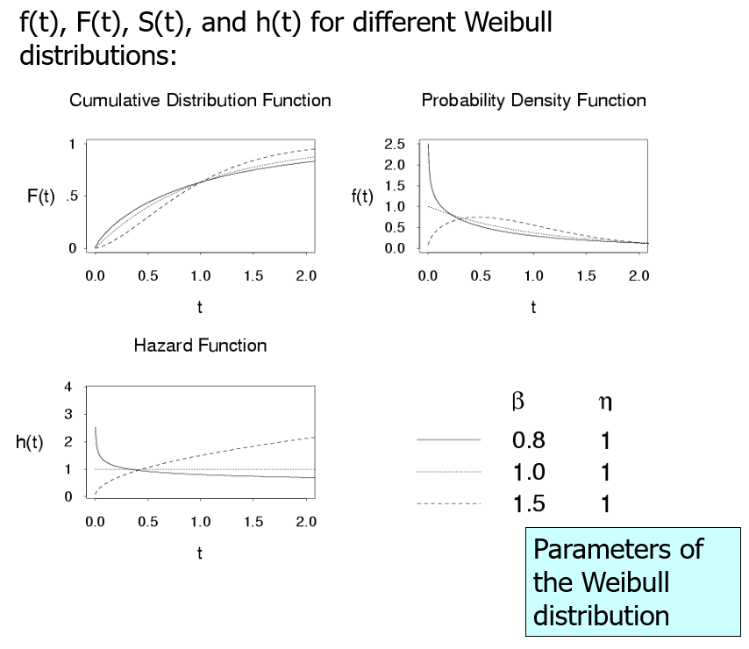
Weibull
(hazard function is increasing or decreasing over time)

Slide 27
Accelerated failure time model

Slide 28
The Proportional Hazard Model
When T~ exponential distribution,
More general,
a baseline hazard function that is left unspecified =the hazard when all covariates are 0

Slide 29

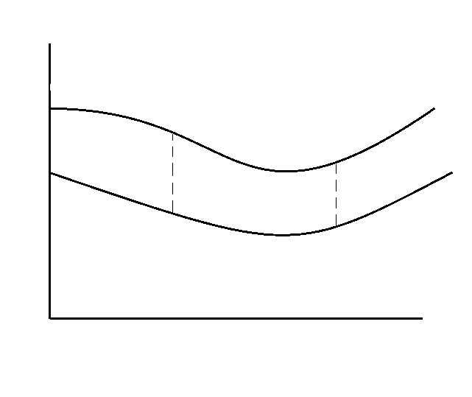
Proportional Hazard
Hazard ratio or relative hazard
h1
h2
b
b

Slide 30
Estimation
For the j^{th} subject, the data recorded are t_{j} the survival time, δ_{j} a censoring indicator with δ_{j} =1 if the survival time is uncensored and δ_{j} =0 if it is censored.
The maximum likelihood estimators can be obtained based on the full likelihood

Slide 31
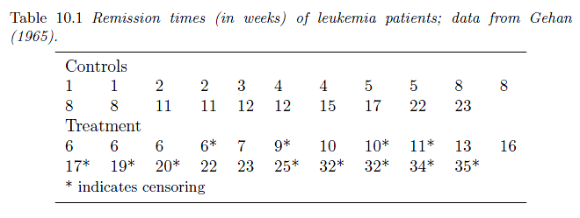
Example
We record the times to remission of leukemia patients. There are two groups each of n = 21 patients. In the control group who were treated with a placebo there was no censoring, whereas in the active treatment group, who were given 6 mercaptopurine, more than half of the observations were censored.

Slide 32
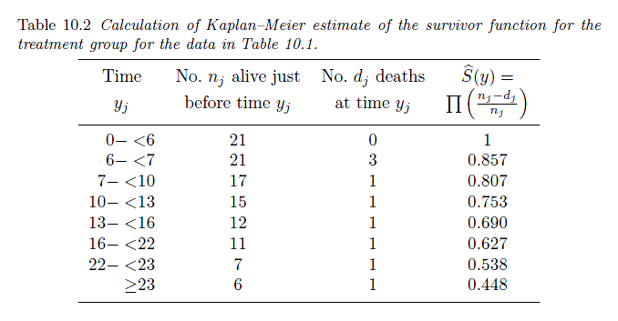

Slide 33
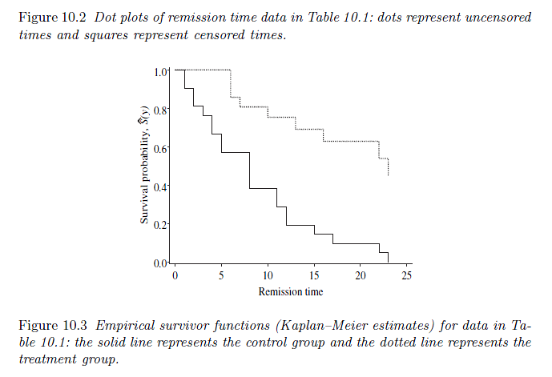

Slide 34
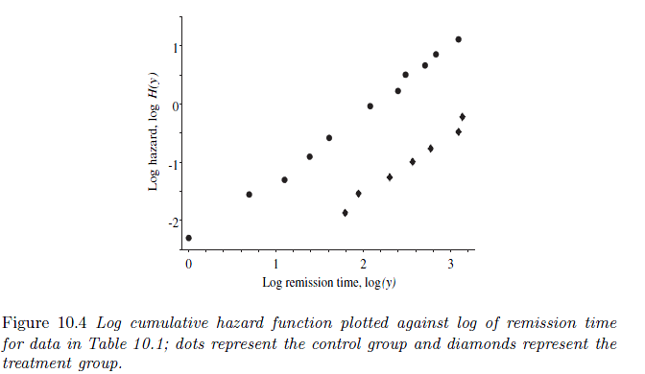
Figure 10.4 shows the logarithm of the cumulative hazard function plotted against log y. The two lines are fairly straight which suggests that the Weibull distribution is appropriate.
Furthermore, the lines are parallel which suggests that the proportional hazards model is appropriate.
The slopes of the linesare near unity which suggests that the simpler exponential distribution may provide as good a model as the Weibull distribution.

Slide 35
Model fit can be assessed using the AIC. For the exponential model AIC = 2.429 and for the Weibull model AIC = 2.782. Therefore, we can conclude that the exponential distribution is about as good as the Weibull distribution for modelling the data but the exponential model would be preferred on the grounds of parsimony. The exponential model suggests that the parameter β₁ is non-zero and provides the estimate exp(1.53) = 4.62 for the relative hazard.

